Slide 1
Retention % of the users on each domain

Slide 2
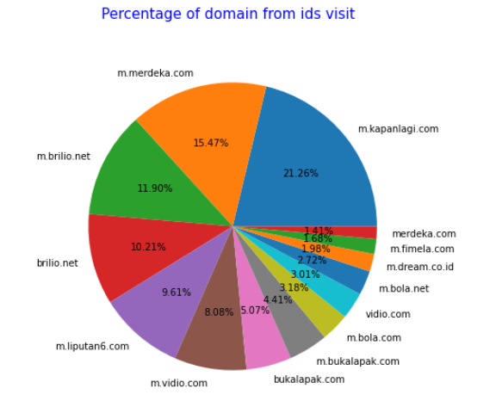
Filtering with value more than 1 % :
m.kapanlagi.com (21.26%)
m.merdeka.com (15.47%)
m.brilio.net (11.90%)
brilio.net (10.21%)
m.liputan6.com (9.61%)
m.video.com (8.08%)
bukalapak.com (5.07%)
m.bukalapak.com (4.41%)
m.bola.com (3.18%)
vidio.com (3.01%)
m.bola.net (2.72%)
m.dream.co.id (1.98%)
m.fimela.com (1.68%)
merdeka.com (1.41%)

